Slide 1

Ethics in Information Technology
Chapter 3
Computer and Internet Crime

Slide 2
Contents
IT Security Incidents
Types of Exploits
Types of Perpetrators
Implementing Trustworthy Computing
Risk Assessment
Establishing a Security Policy
Prevention
Detection
Response

Slide 3
Objectives
As you read this chapter, consider the following questions:
What key trade-offs and ethical issues are associated with the safeguarding of data and information systems?
Why has there been a dramatic increase in the number of computer-related security incidents in recent years?
What are the most common types of computer security attacks?
Who are the primary perpetrators of computer crime, and what are their objectives?

Slide 4
Objectives (cont’d)
What are the key elements of a multilayer process for managing security vulnerabilities based on the concept of reasonable assurance?
What actions must be taken in response to a security incident?
What is computer forensics, and what role does it play in responding to a computer incident?

Slide 5
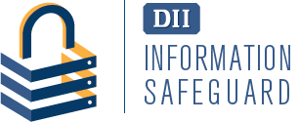

IT Security Incidents: A Major Concern
Security of information technology is of utmost importance
Safeguard
Confidential business data
Private customer and employee data
Protect against malicious acts of theft or disruption
Balance against other business needs and issues
Number of IT-related security incidents is increasing around the world

Slide 6
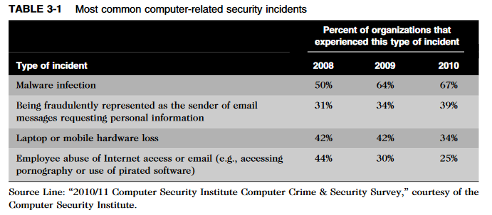
IT Security Incidents: A Major Concern (Cont’d)

Slide 7
Why Computer Incidents Are So Prevalent
Increasing complexity increases vulnerability
Higher user expectations
Expanding/changing systems equal new risks
Increased reliance on commercial software with known vulnerabilities

Slide 8
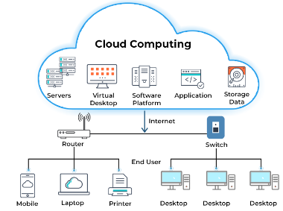
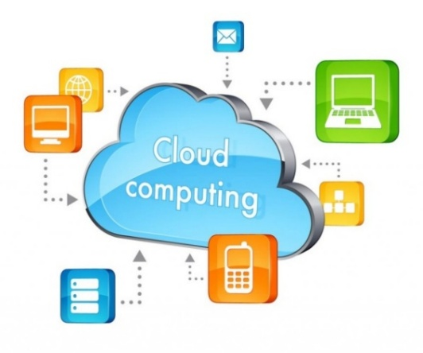
Why Computer Incidents Are So Prevalent (cont’d)
(1) Increasing complexity increases vulnerability
Computing environment is enormously complex
Number of entry points to a network expands continually, increasing the possibility of security breaches
Cloud computing: Environment in which software and data storage are services provided via the Internet.

Slide 9
Why Computer Incidents Are So Prevalent (cont’d)
Virtualization software: Operates in a software layer that runs on top of the operating system
Enables multiple virtual machines to run on a single computer
(2) Higher computer user expectations
Forget to verify users’ IDs or check authorizations
Computer users share login IDs and passwords

Slide 10
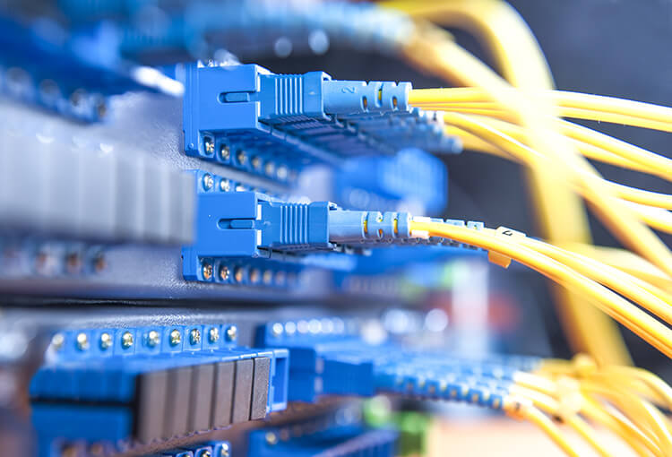
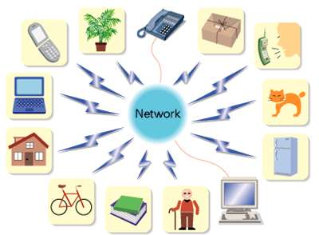
Why Computer Incidents Are So Prevalent (cont’d)
(3) Expanding/changing systems equal new risks
Network era:
Personal computers connect to networks with millions of other computers
all capable of sharing information
Information technology: Ubiquitous and necessary tool for organizations to achieve goals
Keep up with the pace of technological change
Perform an ongoing assessment of new security risks
Implementing approaches for dealing with them

Slide 11
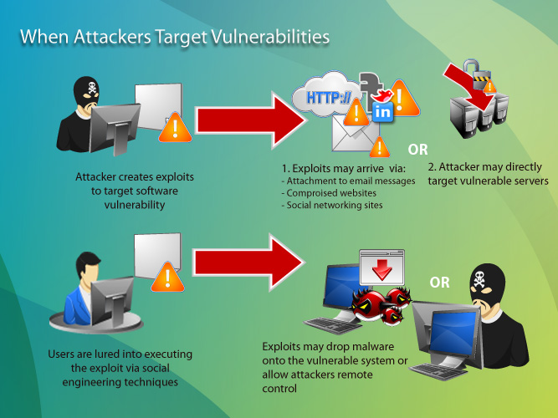
Why Computer Incidents Are So Prevalent (cont’d)
(4) Increased reliance on commercial software with known vulnerabilities
Exploit: Attack on information system that takes advantage of system vulnerability
Due to poor system design or implementation
“Fix” or “ Patch” to eliminate the problem
Users are responsible for obtaining and installing
Delays expose users to security breaches

Slide 12
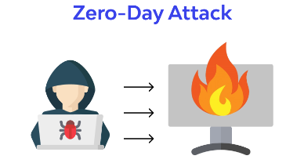
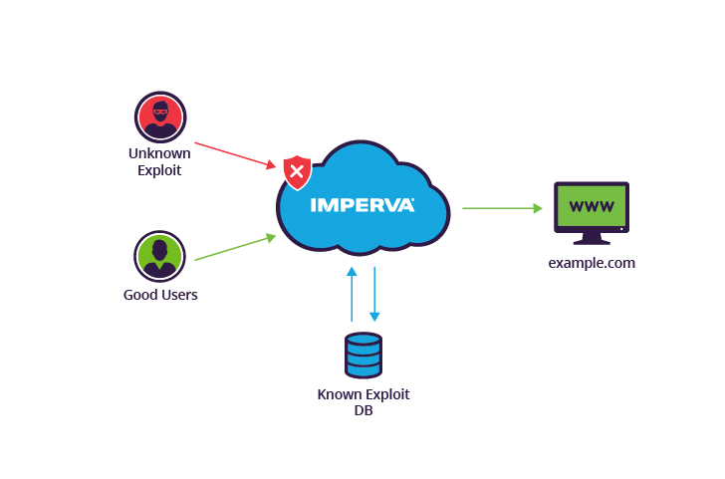
Why Computer Incidents Are So Prevalent (cont’d)
Zero-day attack
Takes place before the security community or a software developer knows about a vulnerability or has been able to repair it

Slide 13
Types of Exploits
Computers as well as smartphones can be target
Types of attacks
Virus
Worm
Trojan horse
Spam
Distributed denial of service
Rootkit
Phishing (spear-phishing, smishing, and vishing)

Slide 14

Types of Exploits (cont’d)
Virus
Virus: Piece of programming code, disguised as something else, that causes a computer to behave in an unexpected and undesirable manner.
Attached to a file
Deliver a “payload”
Spread to other machines when a computer user opens
Infected email attachment
Downloads an infected program
Visits infected Web sites

Slide 15
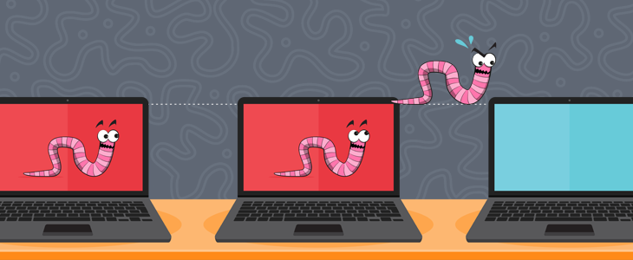
Types of Exploits (cont’d)
Worm
Worms: Harmful program that resides in the active memory of the computer
duplicates itself
Can propagate without human intervention, often sending copies of themselves to other computers by email.

Slide 16
Types of Exploits (cont’d)
Worm
Negative impact of a worm attack
Lost data and programs
Lost productivity
Additional effort for IT workers
The cost to repair the damage done by each of the Code Red, SirCam, and Melissa worms was estimated to exceed $1 billion, with that of the Conficker, Storm, and ILOVEYOU worms totaling well over $5 billion.

Slide 17
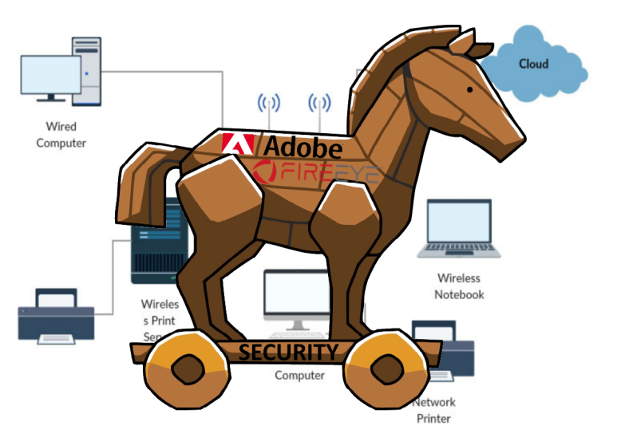

Types of Exploits (cont’d)
Trojan Horse
Trojan Horse: Program in which malicious code is hidden inside a seemingly harmless program
Users are tricked into installing them
Delivered via email attachment, downloaded from a Web site, or contracted via a removable media device
Logic bomb: Executes when it is triggered by a specific event

Slide 18
Types of Exploits (cont’d)
Spam
Spam: Abuse of email systems to send unsolicited email to large numbers of people
low-cost commercial advertising, sometimes for questionable products
Method of marketing also used by many legitimate organizations
Detracts recipients from the ability of recipients to communicate effectively due to full mailboxes
Relevant emails being hidden among many unsolicited messages.

Slide 19
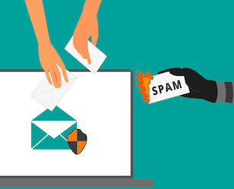

Types of Exploits (cont’d)
Spam
The Controlling the Assault of Non-Solicited Pornography and Marketing (CAN-SPAM) Act went into effect in 2004 and states that it is legal to spam, provided the messages meet a few basic requirements.
Spammers cannot disguise their identity

Slide 20
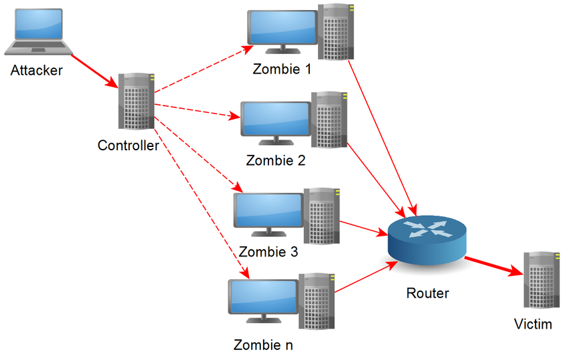
Types of Exploits (cont’d)
Distributed Denial-of-Service (DDoS) Attacks
DDoS Attacks: Causes computers to flood a target site with demands for data and other small tasks
Target machine is busy responding to a stream of automated requests
legitimate users cannot access target machine.

Slide 21
Types of Exploits (cont’d)
DDoS Attacks
Botnet is used to describe a large group of such computers
Controlled from one or more remote locations by hackers, without the knowledge or consent of their owners.
Botnet computers (called zombies) go into action, each sending a simple request for access to the target site again and again

Slide 22
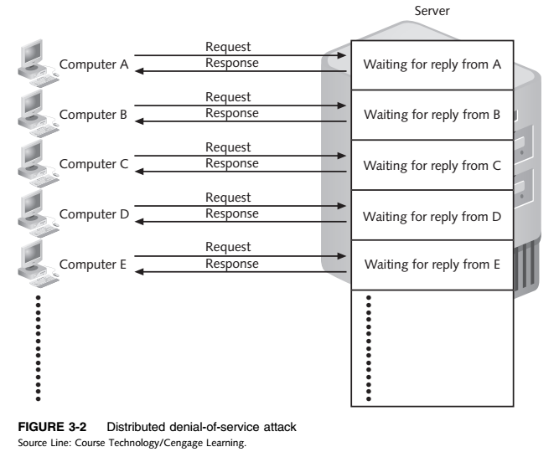
Types of Exploits (cont’d)

Slide 23
Types of Exploits (cont’d)
Rootkits
Rootkits: Enable user to gain administrator-level access to a computer without the end user’s consent or knowledge.
Attacker can gain full control of the system and even obscure the presence of the rootkit.
Attackers can use the rootkit to execute files
Access logs, monitor user activity
Change the computer’s configuration

Slide 24
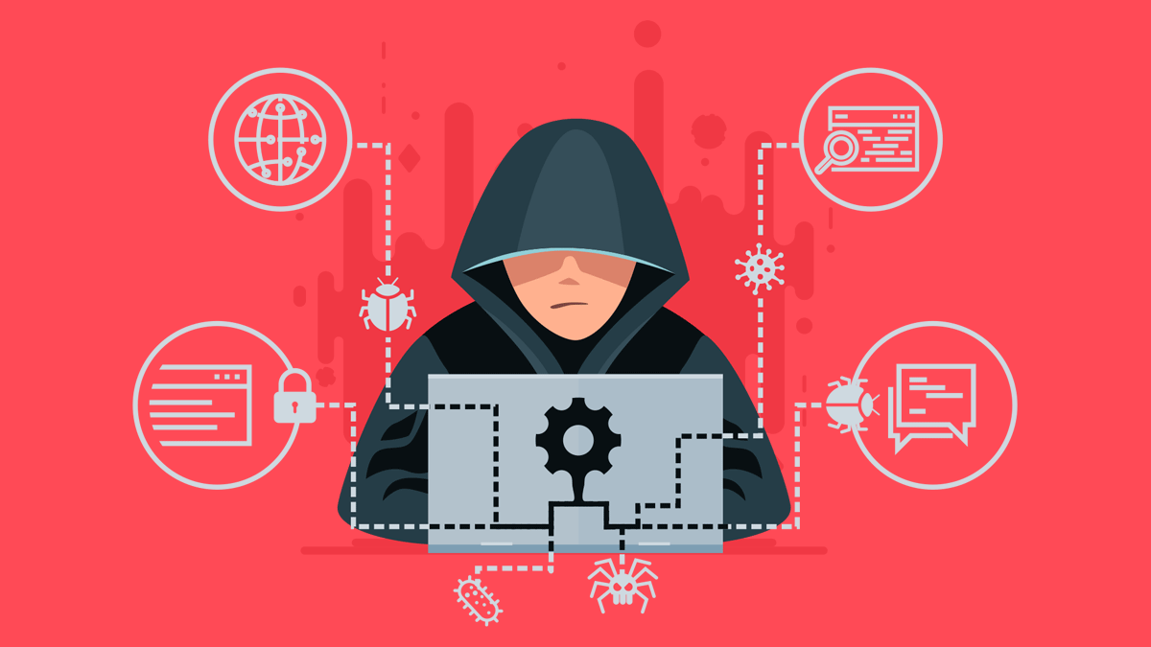
Types of Exploits (cont’d)
Rootkits
Fundamental problem in detecting a rootkit is that the operating system currently running cannot be trusted to provide valid test results.
Dropper code gets a rootkit installation started and can be easily activated by clicking on a link to a malicious Web site in an email or opening an infected PDF file.

Slide 25
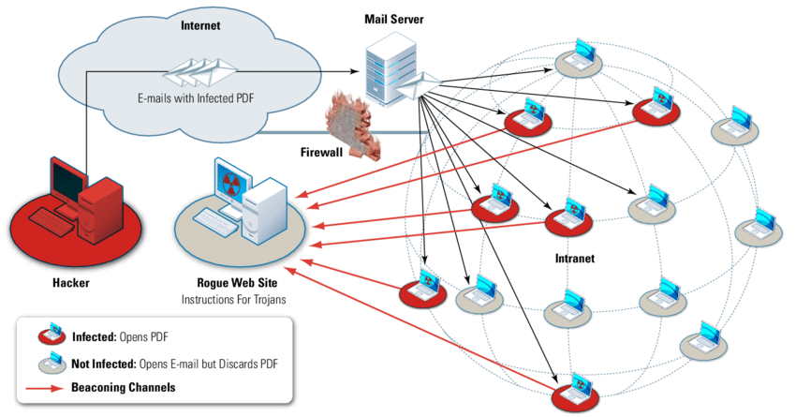
Types of Exploits (cont’d)
Phishing
Phishing: Act of using email fraudulently to try to get the recipient to reveal personal data
Legitimate-looking emails lead users to counterfeit Web sites
Spear-phishing: Fraudulent emails to an organization’s employees designed to look like they came from high­ level executives from within the organization.

Slide 26
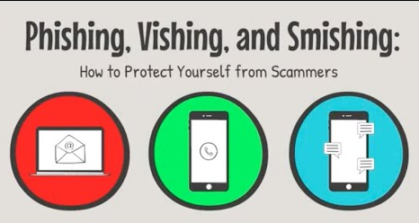
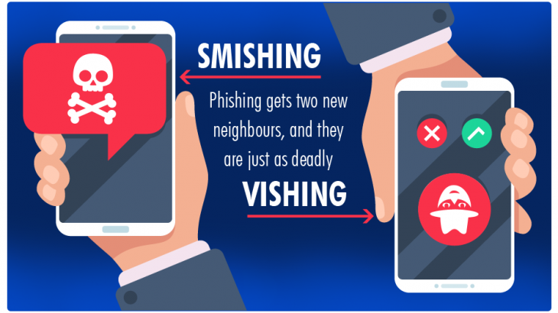
Types of Exploits (cont’d)
Phishing
Smishing: Phishing via text messages
Legitimate-looking text message sent to people, telling them to call a specific phone number or to log on to a Web site.
Vishing: Phishing via voice mail messages
The victims receive a voice mail telling them to call a phone number or access a Web site.

Slide 27
Types of Perpetrators
Perpetrators
Perpetrators include:
Thrill seekers wanting a challenge
Common criminals looking for financial gain
Industrial spies trying to gain an advantage
Terrorists seeking to cause destruction to further their cause
Different objectives and access to varying resources
Willing to take different levels of risk to accomplish his or her objective.

Slide 28
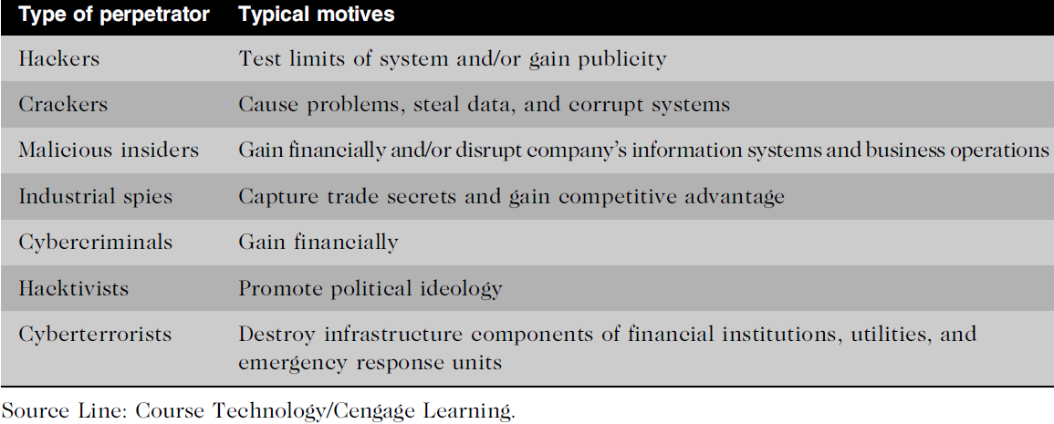
Table 3.5 - Classifying Perpetrators of Computer Crime
Types of Perpetrators (cont’d)

Slide 29
Types of Perpetrators (cont’d)
Hackers and Crackers
Hackers: Test the limitations of information systems out of intellectual curiosity
Some hackers are smart and talented
Lamers or script kiddies: Terms used to refer to technically inept hackers
Crackers: Cracking is a form of hacking
Clearly criminal activity

Slide 30
Types of Perpetrators (cont’d)
Malicious insiders
Malicious Insider: A major security concern for companies
An ever-present and extremely dangerous adversary
Fraud within an organization is usually due to weaknesses in internal control procedures
Collusion: Cooperation between an employee and an outsider
Insiders are not necessarily employees; they can also be consultants and contractors.
Extremely difficult to detect or stop because they are often authorized to access the very systems they abuse.
Negligent Insiders: Poorly trained and inadequately managed employees who cause damage accidently.

Slide 31
Types of Perpetrators (cont’d)
Industrial spies
Industrial spies use illegal means to obtain trade secrets from competitors.
Trade secrets are protected by the Economic Espionage Act of 1996.
Trade secrets are most often stolen by insiders, such as disgruntled employees and exemployees.
Competitive intelligence: Legally obtained data gathered using sources available to the public
Information is gathered from financial reports, trade journals, public filings, and printed interviews with company officials.
Industrial espionage: Using illegal means to obtain information that is not available to the public

Slide 32
Types of Perpetrators (cont’d)
Cybercriminals
Cybercriminals: Hack into computers to steal and engage in computer fraud.
Engage in all forms of computer fraud
Chargebacks are disputed transactions
Loss of customer trust has more impact than fraud
Data breach: Unintended release of sensitive data or the access of sensitive data by unauthorized individuals

Slide 33
Types of Perpetrators (cont’d)
Cybercriminals
Strategies to reduce potential for online credit card fraud
Use encryption technology
Verify the address submitted online against the issuing bank
Request a card verification value (CVV)
Use transaction-risk scoring software
Use smart cards: which contain a memory chip that is updated with encrypted data every time the card is used.

Slide 34
Types of Perpetrators (cont’d)
Hacktivists and Cyberterrorists
Hacktivism: a combination of the words hacking and activism, is hacking to achieve a political or social goal.
Cyberterrorists: launches computer-based attacks to intimidate or coerce an organization in order to advance certain political or social objectives.
Seek to cause harm rather than gather information
Use techniques that destroy or disrupt services.
Consider themselves to be at war
Have a very high acceptance of risk
Seek maximum impact

Slide 35
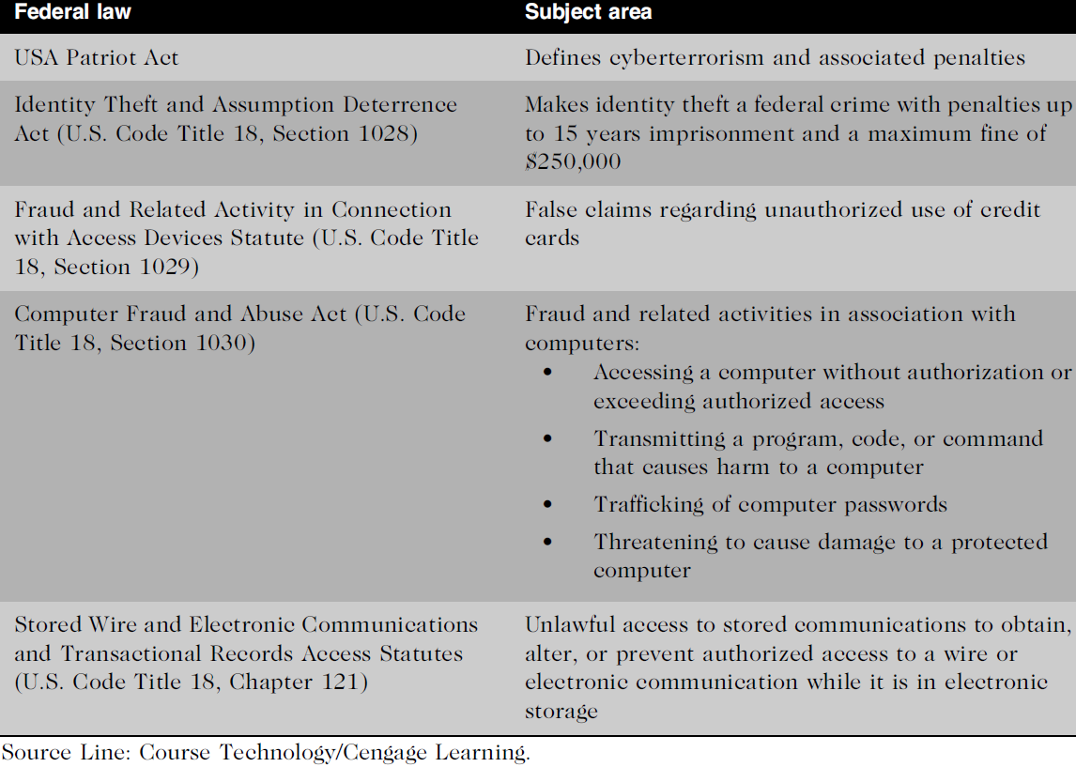
Table 3.6 - Federal Laws that Address Computer Crime
Federal Laws for Prosecuting Computer Attacks

Slide 36
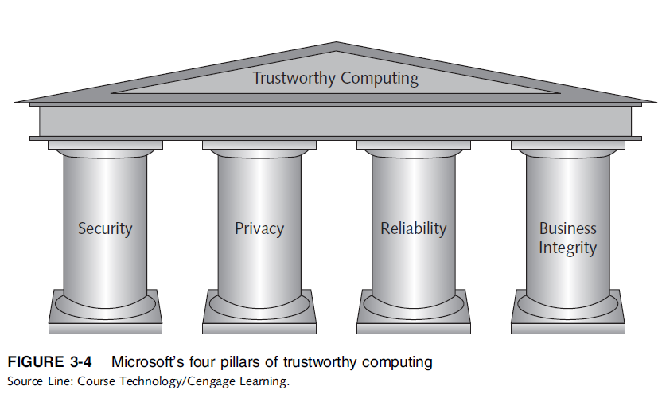
Implementing Trustworthy Computing
Trustworthy Computing
Trustworthy computing: delivers secure, private, and reliable computing experiences
Based on sound business practices

Slide 37
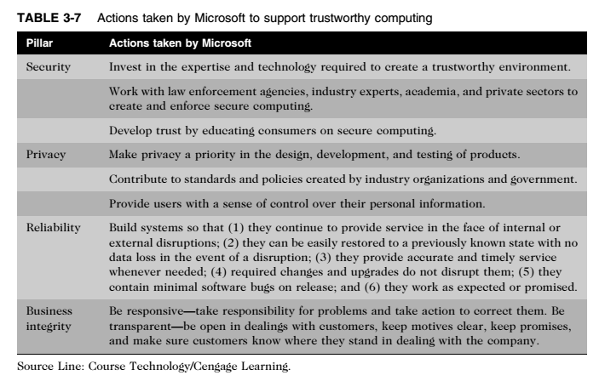
Implementing Trustworthy Computing (cont’d)

Slide 38
Implementing Trustworthy Computing (cont’d)
Trustworthy Computing
Security of any system or network
Combination of technology, policy, and people
Requires a wide range of activities to be effective
Systems must be monitored to detect possible intrusion
Clear reaction plan addresses
Notification, evidence protection, activity log maintenance, containment, eradication, and recovery

Slide 39
Risk Assessment
Risk Assessment
Risk assessment is the process of assessing security-related risks to an organization’s computers and networks from internal and external threats.
The goal of risk assessment is to identify which investments of time and resources will best protect the organization from its most likely and serious threats.
Asset: Hardware, software, information system, network, or database used by an organization to achieve its business objectives.
Loss event : Any occurrence that has a negative impact on an asset

Slide 40
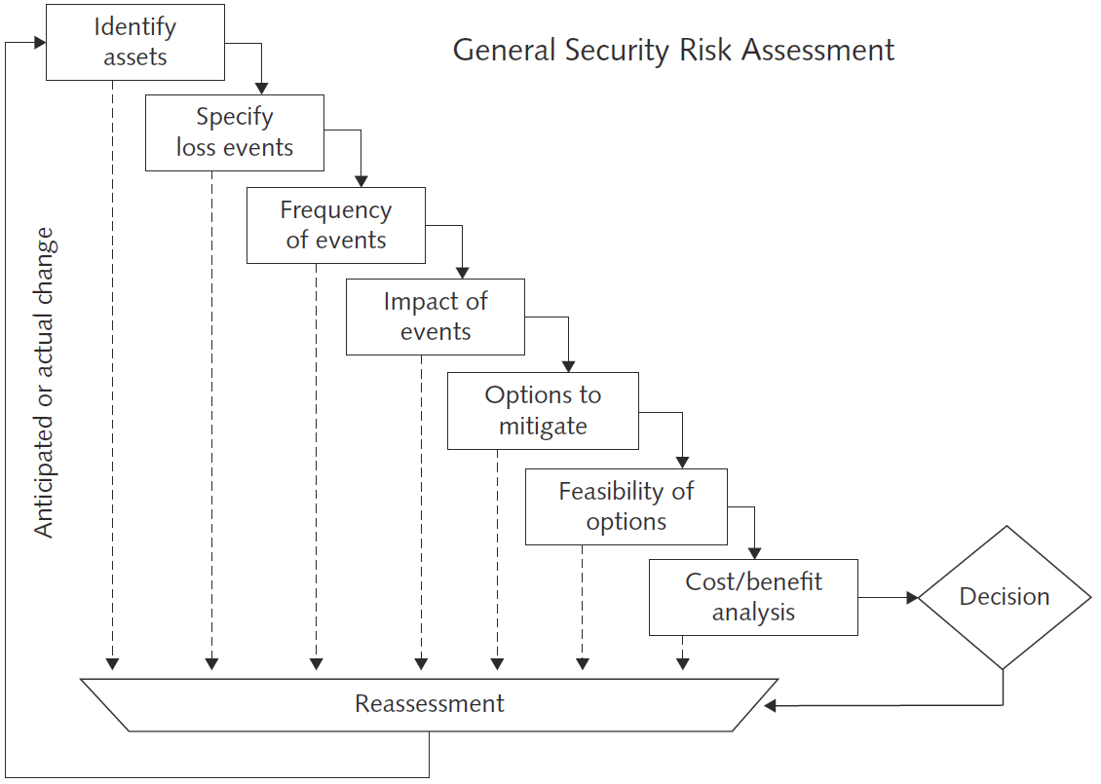
Risk Assessment (cont’d)
Source Line: General Security Risk Assessment Guidelines, ASIS International (2003). See the Standards and Guidelines page of the ASIS International website (www.asisonline.org) for revisions and/or updates. Reprinted by permission.

Slide 41
Risk Assessment (cont’d)
Eight-step risk assessment process
#1 Identify assets of most concern
#2 Identify loss events that could occur
#3 Assess likelihood of each potential threat
#4 Determine the impact of each threat
#5 Determine how each threat could be mitigated
#6 Assess feasibility of mitigation options
#7 Perform cost-benefit analysis
#8 Decide which countermeasures to implement

Slide 42
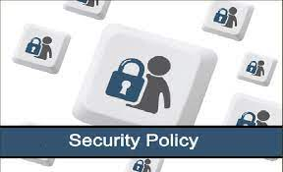
Establishing a Security Policy
Security Policy
Security Policy defines:
Organization’s security requirements
Controls and sanctions needed to meet those requirements
Delineates responsibilities and the behavior expected of members of the organization.
Outlines what needs to be done but not how to do it.
Automated system policies should mirror written policies
When applying system security restrictions, there are some trade-offs between ease of use and increased security.

Slide 43
Establishing a Security Policy (cont’d)
Security Policy
Areas of concern
Use of email attachments
Use of wireless devices
Virtual private network (VPN): Works by using the Internet to relay communications; but it maintains privacy but maintains privacy through security features
Additional security includes encrypting originating and receiving network addresses

Slide 44

Educating Employees and Contract Workers
Motivates them to understand and follow the security policies
Help protect an organization’s information systems and data by:
Guarding their passwords to protect against unauthorized access to their accounts
Prohibiting others from using their passwords
Applying strict access controls
Reporting all unusual activity to the organization’s IT security group
Portable computing and data storage devices are protected

Slide 45
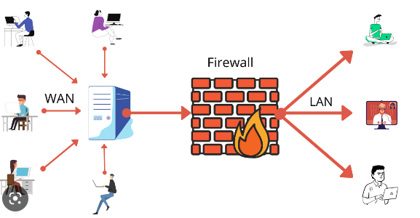
Prevention
The key is to implement a layered security solution to make computer break-ins so difficult that an attacker eventually gives up.
Install a corporate firewall
Firewall stands guard between an organization’s internal network and the Internet,
It limits network access based on the organization’s access policy.

Slide 46
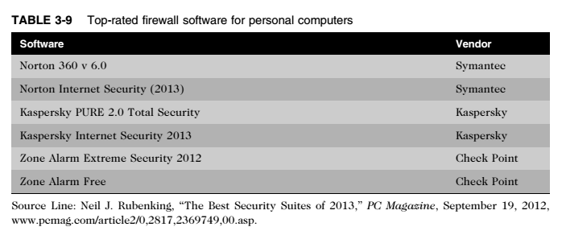
Prevention (cont’d)

Slide 47
Prevention (cont’d)
Intrusion detection system (IDS)
IDS: Monitors system and network resources and activities,
Notifies network security personnel when network traffic attempts to circumvent the security measures
Knowledge-based approaches and behavior-based approaches are two fundamentally different approaches to intrusion detection.
Intrusion Prevention System (IPS)
IPS: Controls system and block viruses, malformed packets, and other threats.

Slide 48
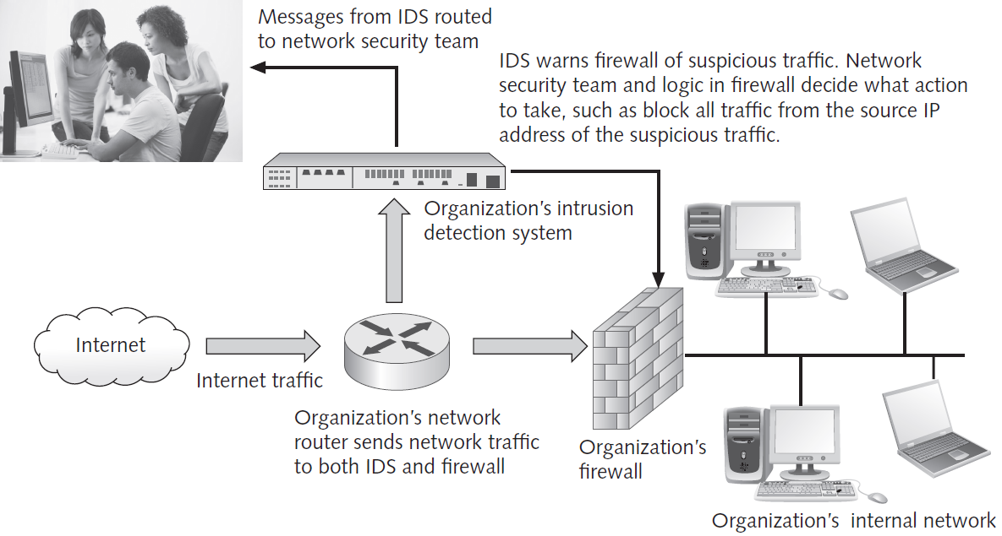
Figure 3.6 - Intrusion Detection System
Prevention (cont’d)
Credit: Monkey Business Images/Shutterstock.com.

Slide 49
Prevention (cont’d)
Installing Antivirus Software on Personal Computers
Antivirus software: scans a computer’s memory and disk drives regularly for viruses.
Scans for a specific sequence of bytes, known as a Virus signature: Indicates the presence of a specific virus
Two of the most widely used antivirus software products are: (1) Norton Antivirus from Symantec and (2) Personal Firewall from McAfee.

Slide 50

Prevention (cont’d)
The United States Computer Emergency Readiness Team (US-CERT) is a partnership between the Department of Homeland Security (DHS) and the public and private sectors established in 2003.
Protect the nation’s Internet infrastructure against cyber attacks.
Serves as a clearinghouse for information on new viruses, worms, and other computer security topics.

Slide 51
Prevention (cont’d)
Implement safeguards against attacks by malicious insiders
User accounts that remain active after employees leave a company are another potential security risk.
To reduce the threat of attack by malicious insiders, IT staff must promptly delete the computer accounts, login IDs, and passwords of departing employees and contractors.
Organizations also need to define employee roles carefully and separate key responsibilities properly.
Another important safeguard is to create roles and user accounts so that users have the authority to perform their responsibilities and nothing more.

Slide 52
Prevention (cont’d)
Defend against cyberterrorism
Department of Homeland Security (DHS): Aims to secure critical infrastructure and information systems
The DHS leads the federal government’s efforts in “securing civilian government computer systems, and works with industry and state, local, tribal, and territorial governments
Builds and maintains a national security cyberspace response system
Implements a cyber-risk management program for protection of critical infrastructure, including banking and finance, water, government operations, and emergency services.

Slide 53

Prevention (cont’d)
Conducting periodic IT security audits
Security audit: Evaluates whether an organization has a well considered security policy in place and if it is being followed.
Review access and levels of authority
Test system safeguards
Information Protection Assessment kit is available from the Computer Security Institute.

Slide 54
Detection Systems
Catch Intruders in the Act
Minimize the Impact of Intruders

Slide 55
Response
Response plan
Develop well in advance of any incident
Approved by:
Legal department
Senior management
Primary goals
Regain control and limit damage
Not to monitor or catch an intruder

Slide 56
Response (cont’d)
Incident notification
Define who to notify and who not to notify
Security experts recommend against releasing specific information about a security compromise in public forums.
Protection of evidence and activity logs
Document all details of a security incident as it works to resolve the incident.
Capture all system events, the specific actions taken (what, when, and who), and all external conversations (what, when, and who) in a logbook.

Slide 57
Response (cont’d)
Incident Containment
Determine if an attack is dangerous enough to warrant shutting down the systems or disconnecting critical systems from the network.
Eradication
Collect and log all criminal evidence from the system.
Verify that all backups are current, complete, and free of any virus.
After virus eradication, the group must create a new backup.

Slide 58
Response (cont’d)
Incident follow-up
Determine how the security was compromised
Review should be conducted after an incident to determine exactly what happened and to evaluate how the organization responded.
Weigh carefully the amount of effort required to capture the perpetrator
Consider the potential for negative publicity
Legal precedent
Hold organizations accountable for their own IT security weaknesses

Slide 59
Computer Forensics
Combines elements of law and computer science to:
Identify, collect, examine, and preserve data from computer systems
Collect data in a manner that preserves the integrity of the data gathered so that it is admissible as evidence in a court of law
Requires extensive training and certification and knowledge of laws that apply to gathering of criminal evidence.

Slide 60
Summary
Ethical decisions in determining which information systems and data most need protection
Most common computer exploits
Types of Perpetrators

Slide 61
Summary (Cont’d)
Must implement multilayer process for managing security vulnerabilities, including:
Assessment of threats
Identifying actions to address vulnerabilities
User education
IT must lead the effort to implement:
Security policies and procedures
Hardware and software to prevent security breaches
Computer forensics is key to fighting computer crime in a court of law

Slide 62
Additional Resources
To learn more about zero day attacks, visit: http://www.informationweek.com/news/security/attacks/231601692
To learn more about viruses, visit: http://goo.gl/Zgf9q
The CERT/CC Web site: http://www.cert.org/
The SANS Web site newsletter, with links to articles on Internet Security: http://www.sans.org/newsletters/newsbites/newsbites.php?vol=5&issue=42
The Defcon Web site: http://www.defcon.org

Slide 63
Reference
Ethics in information technology 5th Edition
Pictures are from the internet

